Slide 1
Week 11
Alexey V. Zimin
JHU BME 580.417/707

Slide 2
Ab initio gene finding
Transcriptome sequencing data does not provide comprehensive picture of expression – not all transcripts are expressed in all cells at the same time:
Sequence many different cells under many conditions (expensive)
Supplement transcriptome sequencing data with an ab initio gene finding algorithm to find transcripts that a not expressed
Assembled transcripts have errors:
Use machine learning algorithms to detect errors in assembled transcripts
Machine learning:
Positional Weights/Markov chain/Hidden Markov Models
Convolution Neural Networks?

Slide 3
Machine learning algorithms
Protein coding and non-coding sequences have different patterns of letters
Spliceosome does not just cut out introns at GT-AG, it recognizes longer patterns around splice sites
We can look for the patterns with machine learning algorithms
We can model and test the patterns with:
Positional Probabilities or Positional Weights
Markov chains
Hidden Markov Models

Slide 4
Markov chains and HMMs
We can use Positional Probabilities and Markov chains to test whether the sequence patterns around features (such as splice sites GT-AG) correspond to what is expected, which allows us to:
Look for new features
Test for correctness of existing features obtained from the data
We will consider application of Positional Probabilities and Markov chains to splice site prediction/validation
We can use HMMs to locate regions of sequence that appear to have different properties (coding vs. non-coding)

Slide 5
Positional Probabilities
Positional probabilities is the most straightforward approach to detecting and testing sequence patterns
Positional probabilities simply quantify the probabilities of observing A,C,G,T at a certain location in genomic sequence

Slide 6

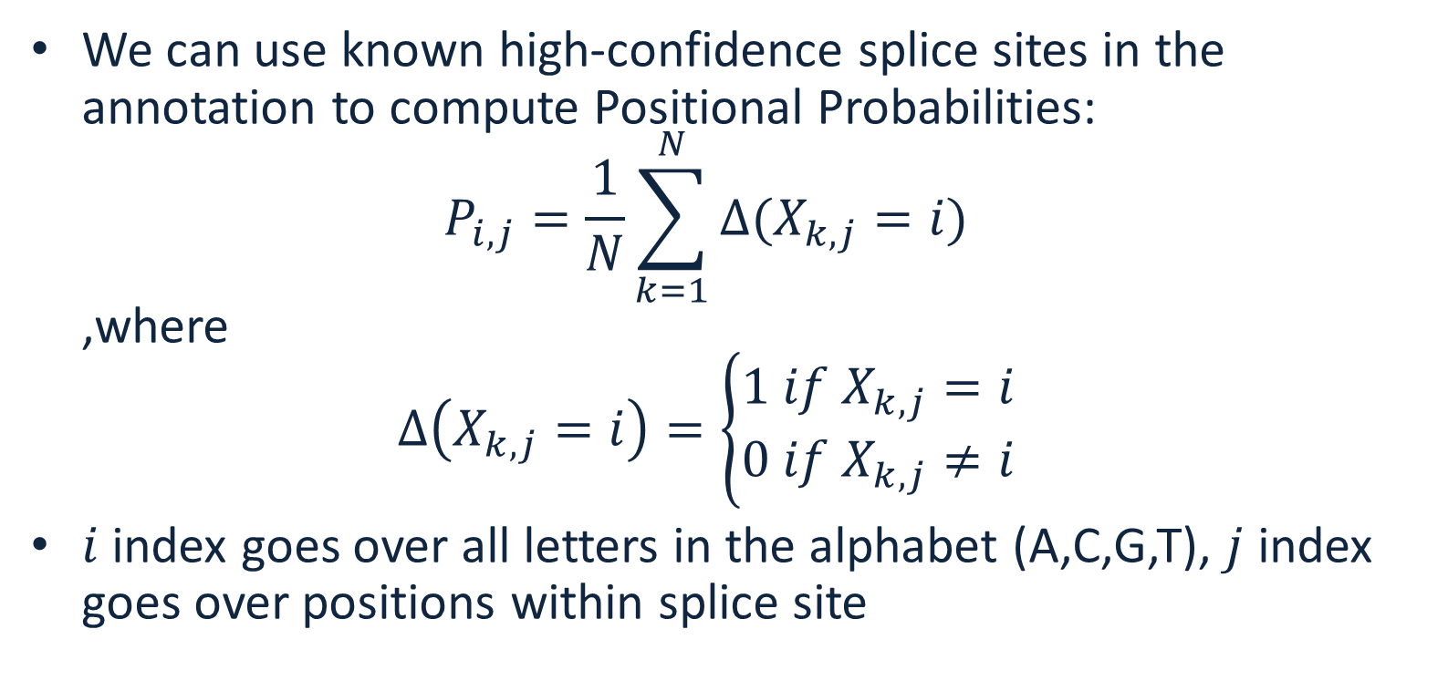
Positional probabilities
We can use known high-confidence splice sites in the annotation to compute Positional Probabilities: $P_{i,j}=\frac{1}{N}\sum_{k=1}^{N}{∆(X_{k,j}=i)}$ ,where $∆\left(X_{k,j}=i\right)=\left\{\begin{matrix}1 if{ X}_{k,j}=i \\ 0 if{ X}_{k,j}≠i\end{matrix}\right.$
$i$ index goes over all letters in the alphabet (A,C,G,T), $j$ index goes over positions within splice site

Slide 7
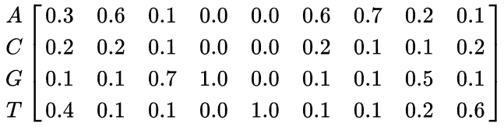

Example
Given DNA sequences:
The Positional Probability Matrix (PPM) is
Computing these probabilities from the data is the learning part
$P_{i,j}=$

Slide 8
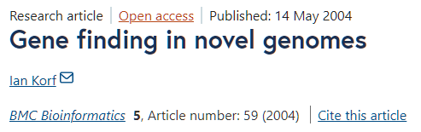
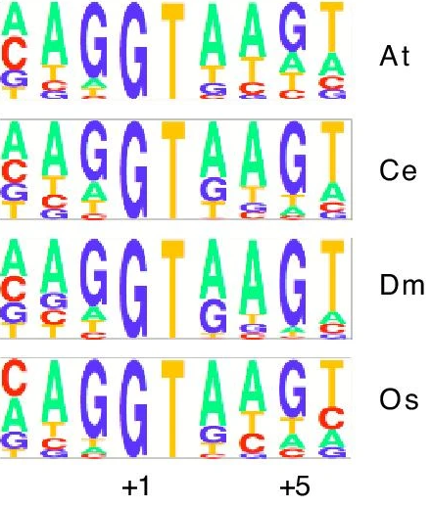
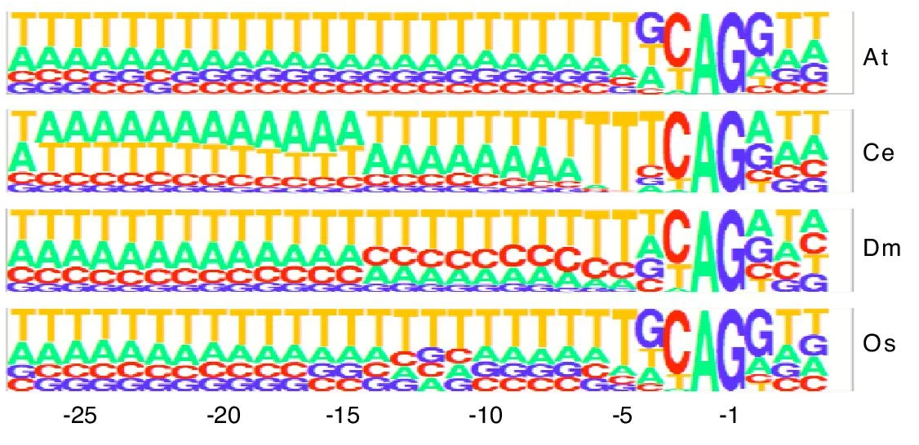
Splice site patterns
Donor (GT)
Acceptor (AG)

Slide 9

Using PWM to evaluate pattern
We can calculate the probability of a sequence given a PPM, by multiplying the relevant probabilities at each position. For example, the probability of the sequence S = GAGGTAAAC can be calculated:
Compare this to the probability of a random sequence (all probabilities are 0.25) 0.25^9=0.0000038
${P_{i,j}}_{ }=$
$${p(S|P}_{i,j})=.1∗.6∗.7∗1∗1∗.1∗.7∗.2∗.2=0.0007056$$

Slide 10
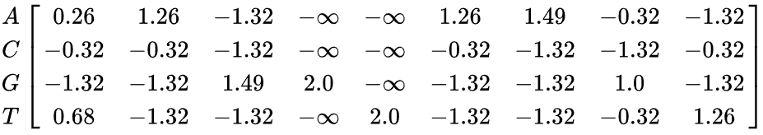
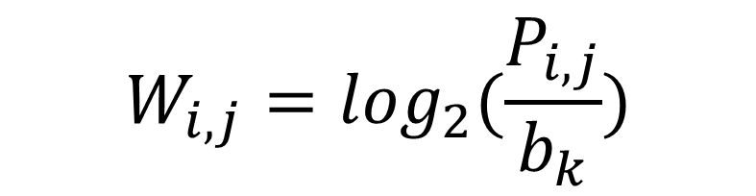
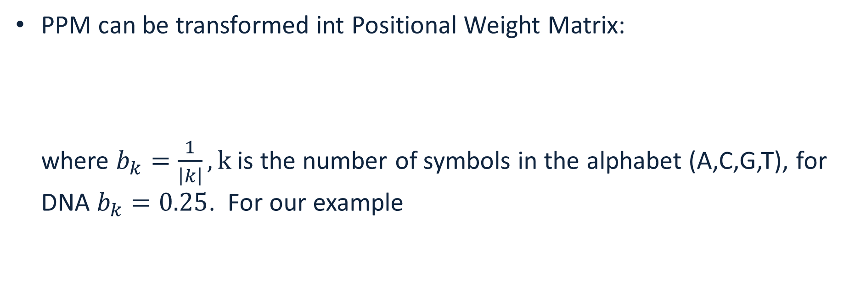

PPM vs PWM
PPM can be transformed int Positional Weight Matrix: where $b_{k}=\frac{1}{\left|k\right|}, k$ is the number of symbols in the alphabet (A,C,G,T), for DNA $b_{k}=0.25$. For our example
$$W_{i,j}=\log_{2}(\frac{P_{i,j}}{b_{k}})$$
$$W_{i,j}=$$

Slide 11

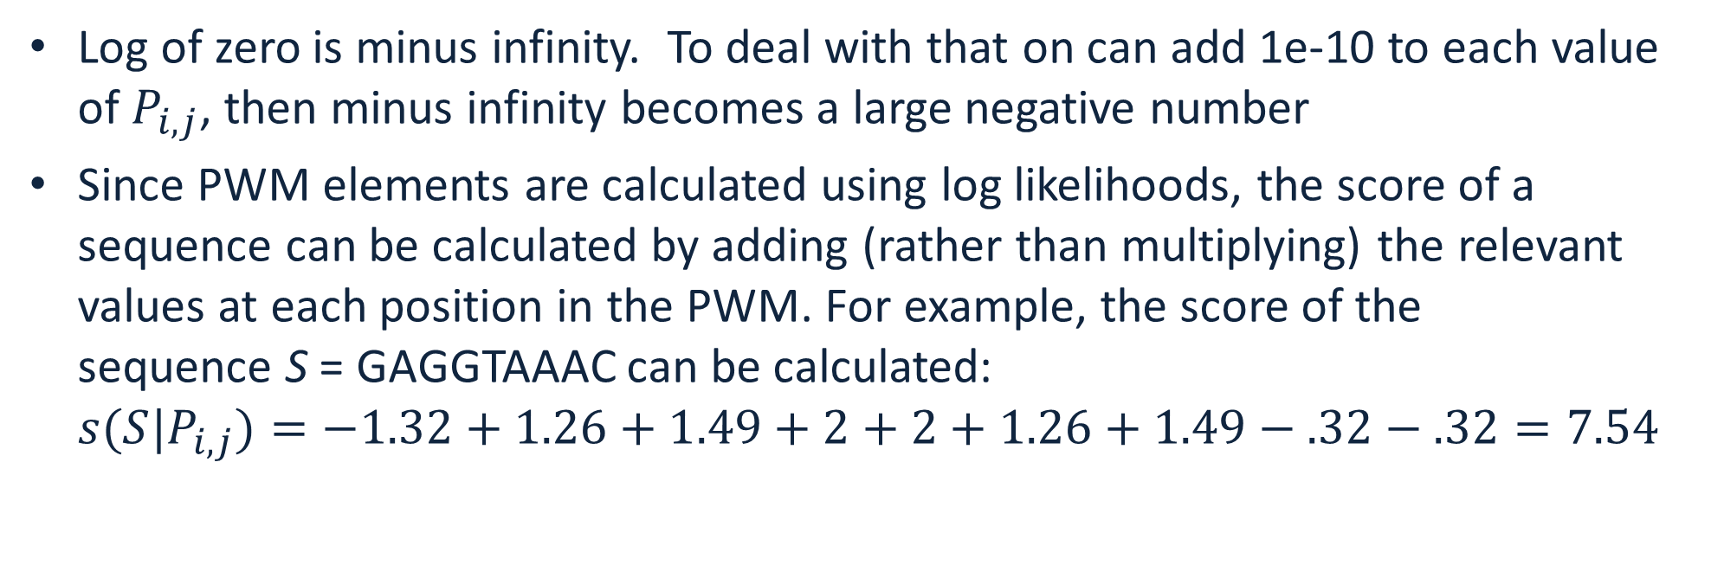
Scoring with PWMs
Log of zero is minus infinity. To deal with that on can add 1e-10 to each value of $P_{i,j}$, then minus infinity becomes a large negative number
Since PWM elements are calculated using log likelihoods, the score of a sequence can be calculated by adding (rather than multiplying) the relevant values at each position in the PWM. For example, the score of the sequence S = GAGGTAAAC can be calculated: ${s(S|P}_{i,j})=−1.32+1.26+1.49+2+2+1.26+1.49−.32−.32=7.54$
$$W_{i,j}=$$

Slide 12
PWM score
The sequence score gives an indication of how different the sequence is from a random sequence (all weights are the same).
The score is 0 if the sequence has the same probability of being a valid pattern (splice site) and of being a random site.
The score is greater than 0 if it is more likely to be a valid splice site than a random site, and less than 0 if it is more likely to be a random site than a valid splice site.
This can be generalized to look or test any feature (donor splice site, acceptor splice site, coding start, coding stop)

Slide 13
Drawback of PWMs
PWMs assume statistical independence between positions in the pattern, as the probabilities for each position are calculated independently of other positions.
This assumption does not match reality for splice site patterns
Longer correlations are present

Slide 14
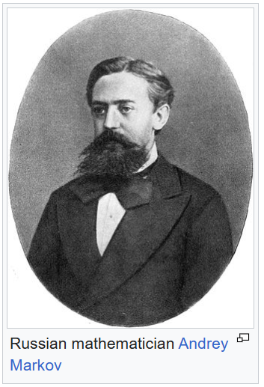
Markov chain
Markov chains allow one to quantify correlations in patterns
Markov chain or Markov process is a stochastic process describing a sequence of possible events in which the probability of each event depends only on the state attained in the previous event.
Informally, this may be thought of as, "What happens next depends only on the state of affairs now."
Markov processes are named in honor of the Russian mathematician Andrey Markov.

Slide 15
Markov chain
We will consider Discrete-time Markov Chains
A discrete-time Markov chain is a sequence of random variables X₁, X₂, X₃, ... with the Markov property, namely that the probability the next state depends only on the previous states:
Order of the Markov chain is equal to the number of the previous states considered to determine the probability of the next state

Slide 16

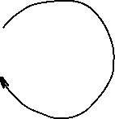

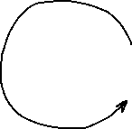
Markov model
Markov model has:
A set of states
Transition probabilities between states
Probabilities of the starting states
Transition probability matrix:
To
B G
From B 0.2 0.8
G 0.5 0.5
Starting probabilities
Pr(B) = 0.6
Pr(G) = 0.4
Markov walk:
BGGBGBGGGBBGBGGGBGGGGB
Outgoing probabilities must sum to 1 !
0.2
0.8
0.5
0.5

Slide 17

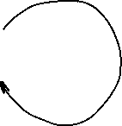

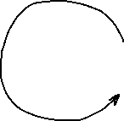
Markov model
For any observed walk we can compute probability that this process generated the walk:
Pr(BGGB)=0.6*0.8*0.5*0.5=0.072
How is this probability useful? We can use it to distinguish between two Markov Processes!
Transition probability matrix:
To
B G
From B 0.2 0.8
G 0.5 0.5
Starting probabilities
Pr(B) = 0.6
Pr(G) = 0.4
0.2
0.8
0.5
0.5

Slide 18
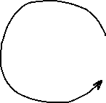

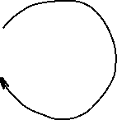
Markov model
Process A Pr(BGGB)=0.6*0.8*0.5*0.5=0.072
Process B Pr(BGGB)=0.5*0.5*0.5*0.5=0.0625
Process A is more likely!
Process A: Starting probabilities Pr(B)=0.6, Pr(G)=0.4
0.2
0.8
Process B: Starting probabilities Pr(B)=0.5, Pr(G)=0.5
0.5
0.5
0.5
0.5
0.5
0.5

Slide 19

Training Markov chain
Training Markov chain involves estimating transition probability matrix from the data under a given model
1st order Markov chain for DNA: the probability of the next letter depends only on the previous letter in the pattern
One can estimate transition probabilities by counting all tuples T_{i}=(“AA”,”AC”,”AG”,”AT”,”CA”,....,”TT”) in the DNA data, and dividing the count of each tuple starting with A, C, G, T by the total number of T_{i} starting with A, C, G and T To A C G T A .1 .4 .4 .1 From C .2 .2 .3 .3 G .4 .4 .1 .1 T .5 .1 .2 .2 rows must add up to 1
A
C
G
T

Slide 20

Scoring with Markov chain
Imagine sequence AGCG, all starting probabilities are equal to 0.25. Its probability under this Markov model is P = 0.25*0.4*0.4*0.3=0.012
Probability that this sequence has ben generated from a random walk is 0.25⁴ = 0.00390625
You can compare probabilities between different Markov chain models to see which model is more likely to have generated the pattern To A C G T A .1 .4 .4 .1 Model 1 From C .2 .2 .3 .3 G .4 .4 .1 .1 T .5 .1 .2 .2 To A C G T A .25 .25 .25 .25 Model 2 From C .25 .25 .25 .25 (random walk) G .25 .25 .25 .25 T .25 .25 .25 .25
A
C
G
T

Slide 21
Markov Weight Array Matrix
A Weight Array Matrix (WAM) is a specific kind of Markov chain model that incorporates positions within the pattern
WAM works better than PWM in scoring patterns because it incorporates Markov chain transition probabilities: the probability of each letter depends both on the position and on the previous one (or more) letters
The Markov process weights change from one position to another within the pattern
For the first order Markov process we need 16 weights at each position

Slide 22

PWM vs WAM
PWM -- probabilities of observing each letter at a given position only depend on the position in the pattern: 123456789 GAATGAGA here the probability of seeing A at the position 2 is a number that only depends on the position (2)
1st order Markov WAM -- probabilities of observing each letter at a given position depend on the position in the pattern and on the previous letter: 123456789 GAATGAGA here the probability of seeing A at the position 2 is a number that depends on the position (2) and on the previous letter (G)

Slide 23


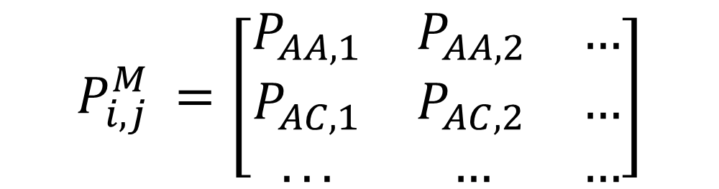

Markov Weight Array Matrix
1st order Markov WAM based on on the 1st order Markov chain
Computation of probabilities is the same as for the Positional Probabilities, except the alphabet is tuples (AA,AC,AG,AT,CA,....,TT), size=16
Let each tuple be . Estimate from the data probabilities for every ; for a pattern of length n, the matrix will have dimensions 16 by (n-1)
$$T_{i}$$
$$T_{i}$$
$$P_{i,j}^{M}$$
$${P_{i,j}^{M}}_{ }=\left[\begin{matrix}P_{AA,1} & P_{AA,2} & … \\ P_{AC,1} & P_{AC,2} & … \\ ... & … & …\end{matrix}\right]$$

Slide 24
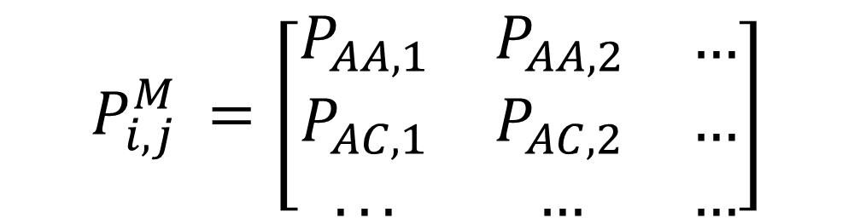

Markov Weight Array Matrix
$P_{i,j}^{M}=\frac{1}{N}\sum_{k=1}^{N}{∆(X_{k,j}=i)}, X^{′}s and i^{′}s$ are now AA,AC,AG,… etc
$$∆\left(X_{k,j}=i\right)=\left\{\begin{matrix}1 if{ X}_{k,j}=i \\ 0 if{ X}_{k,j}≠i\end{matrix}\right.$$
The idea is the same as for positional probabilities, but now you are working with tuples of letters: e.g. instead of counting how many times you’ve seen A, C, G or T in the first position, you count how many times you’ve seen AA, AC,…. in the first position, etc
$${P_{i,j}^{M}}_{ }=\left[\begin{matrix}P_{AA,1} & P_{AA,2} & … \\ P_{AC,1} & P_{AC,2} & … \\ ... & … & …\end{matrix}\right]$$

Slide 25
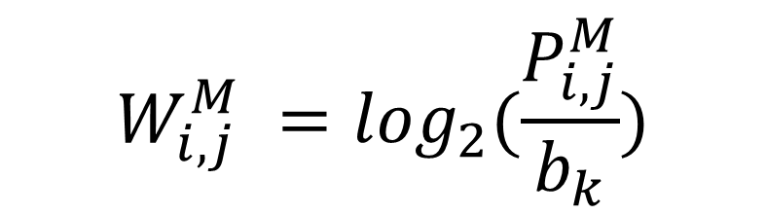
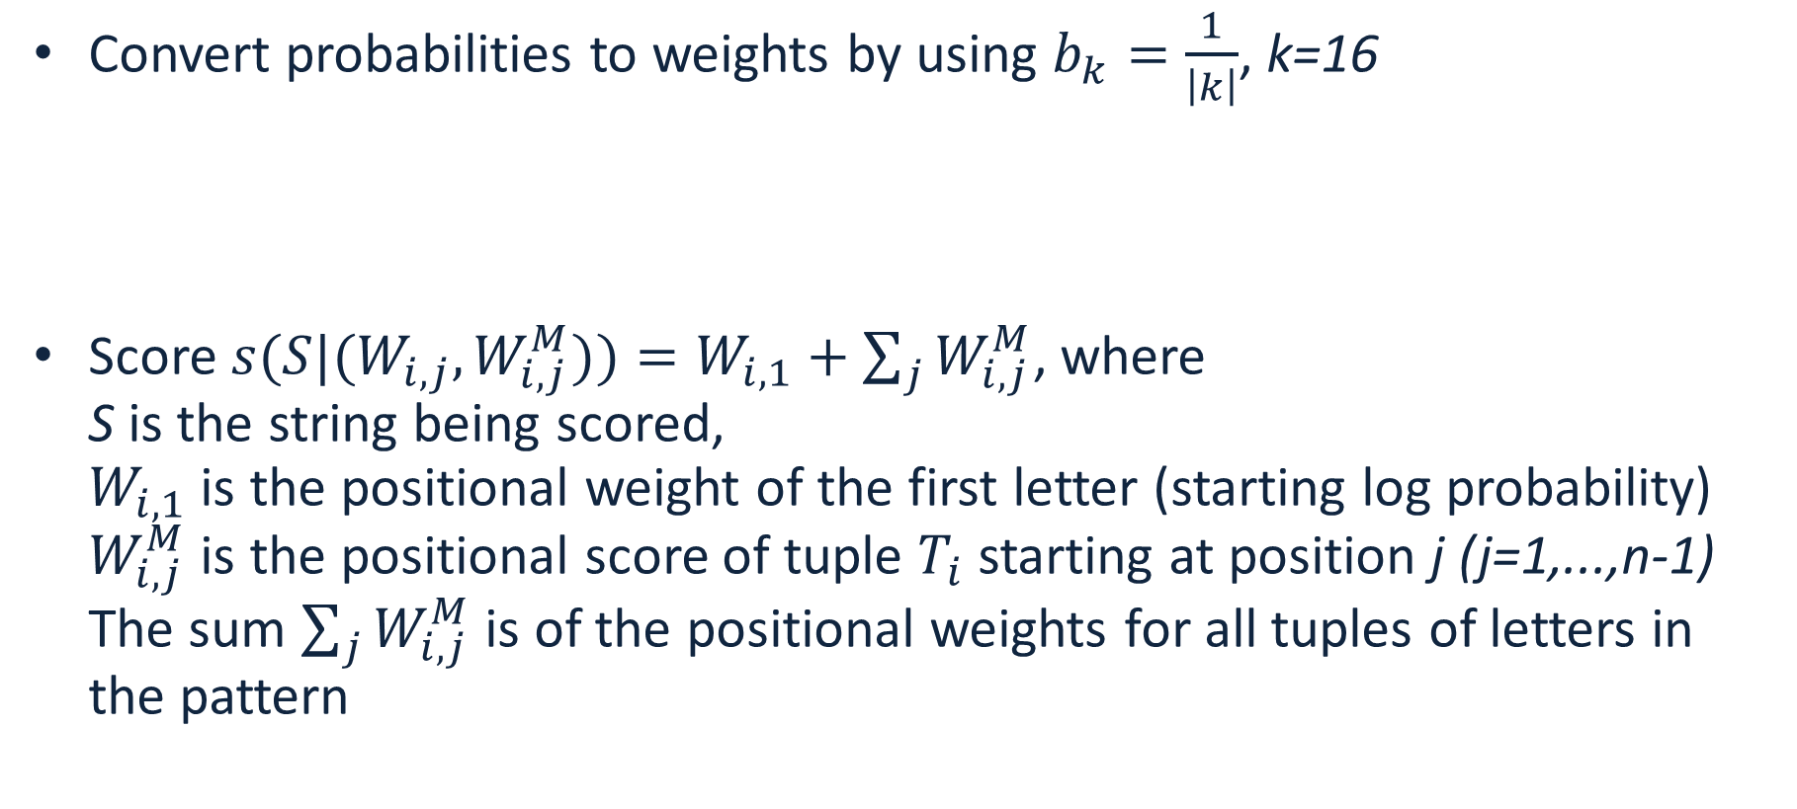
Scoring pattern with Markov WAM
Convert probabilities to weights by using $b_{k}=\frac{1}{\left|k\right|}$, k=16
Score ${s(S|(W}_{i,j},W_{i,j}^{M}))=W_{i,1}+\sum_{j}{W_{i,j}^{M}}$, where S is the string being scored, $W_{i,1}$ is the positional weight of the first letter (starting log probability) $W_{i,j}^{M}$ is the positional score of tuple $T_{i}$ starting at position j (j=1,...,n-1) The sum $\sum_{j}{W_{i,j}^{M}}$ is of the positional weights for all tuples of letters in the pattern
$$W_{i,j}^{M} =\log_{2}(\frac{P_{i,j}^{M}}{b_{k}})$$

Slide 26
Estimation of negative hypothesis
Weight Array or Markov chain score is related to the probability that the Markov process(es) generated the pattern
One can compare it to the “negative” hypothesis -- score under a model trained on randomly chosen “invalid” patterns: genome sequences of length n that are not valid patterns
A reasonable assumption is that for the negative hypothesis all probabilities are the same, so the sum of the weights is 0 (zero), thus a score above zero indicates a match to the pattern
Genomes with strong GC-bias (more G’s and C’s compared to A’s and T’s) fail that assumption

Slide 27
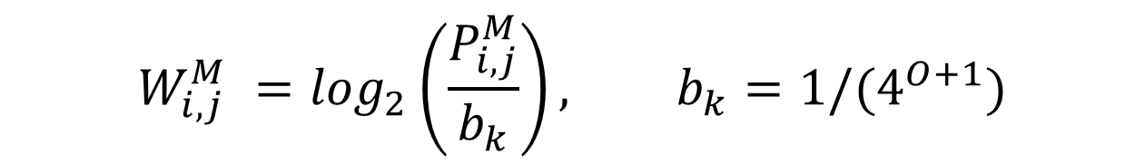
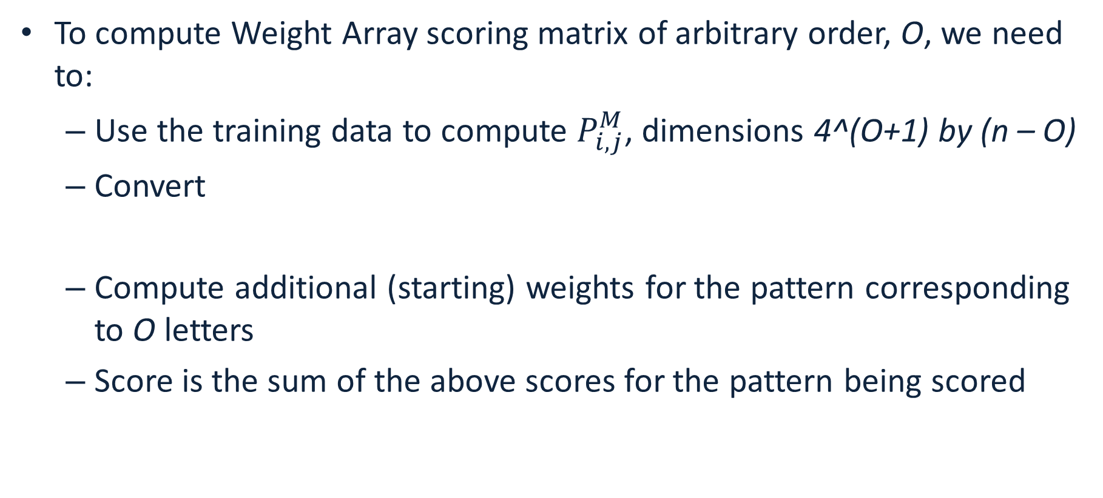
Extend to arbitrary order
To compute Weight Array scoring matrix of arbitrary order, O, we need to:
Use the training data to compute $P_{i,j}^{M}$, dimensions 4^(O+1) by (n – O)
Convert
Compute additional (starting) weights for the pattern corresponding to O letters
Score is the sum of the above scores for the pattern being scored
$$W_{i,j}^{M} =\log_{2}\left(\frac{P_{i,j}^{M}}{b_{k}}\right), b_{k}={1/(4}^{O+1})$$

Slide 28
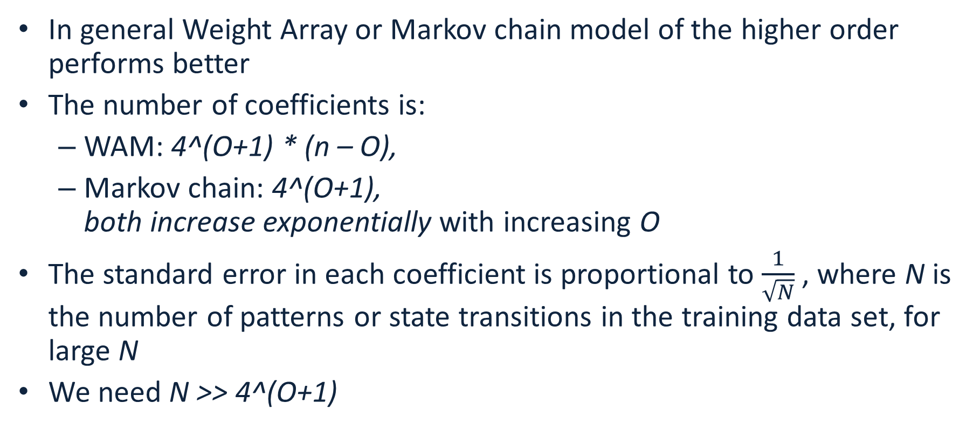
How to choose the order of Markov chain or WAM
In general Weight Array or Markov chain model of the higher order performs better
The number of coefficients is:
WAM: 4^(O+1) * (n – O),
Markov chain: 4^(O+1), both increase exponentially with increasing O
The standard error in each coefficient is proportional to $\frac{1}{\sqrt{N}}$, where N is the number of patterns or state transitions in the training data set, for large N
We need N >> 4^(O+1)

Slide 29
Hidden Markov Models
Imagine that we cannot observe/measure the states directly, but the states emit data
The goal is to determine the most likely sequence of states given the model and the observed data
0.8
0.2
0.8
0.2

Slide 30

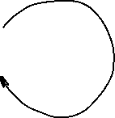

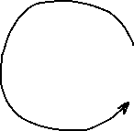
Hidden Markov Models
A Hidden Markov Model is a Markov model that emits data at each state with different probability distributions, and transition probabilities are known (or can be estimated)
Blue state emits data distributed according to probabilities P_{b} and Green state emits data distributed with probabilities P_{g}
0.8
0.2
0.8
0.2

Slide 31
The game
Imagine the following game:
One coin is fair: probability of heads or tails is 50%
One coin is biased: probability of heads is 90%
Coins look identical to us (state cannot be observed directly)
The game (repeats N times):
Dealer picks a coin with probability 50% in secret, flips it and makes the result visible
Dealer then switches the coin with probability 20% in secret
Our goal is to guess which coin is used at every toss
0.8
0.2
0.8
Fair (F)
Bias (B)
0.2

Slide 32
Hidden Markov Models
A walk in HMM from the dealer’s perspective: FFBB HTHH
We observe: HTHH
0.8
0.2
0.8
Fair (F)
Bias (B)
0.2

Slide 33
Hidden Markov Models
A walk in HMM from the dealer’s perspective: FFBB HTHH
It is easy for the dealer to compute the probability: Pr(FFBB)=Pr(start in F)*Pr(emit H in F)*Pr(stay in F)* Pr(emit T in F)* Pr(switch to B)* Pr(emit H in B)*Pr(stay in B)* Pr(emit H in B) = 0.5*0.5*0.8*0.5*0.2*0.9*0.8*0.9
0.8
0.2
0.8
Fair (F)
Bias (B)
0.2

Slide 34
Hidden Markov Models
A walk in HMM from the dealer’s perspective: FFBB HTHH
What can we do? The coins are hidden from us!
Try all possible sequences of 4-letter combinations of F and B, compute probabilities (2^4)
0.8
0.2
0.8
Fair (F)
Bias (B)
0.2

Slide 35
Hidden Markov Models
F
B
F
B
F
B
2^4=16 probabilities,
Pick the guess with the highest probability
Not feasible to do for long runs!!!
F
B
F
B
F
B
F
B
F
B
F
B
F
B
F
B
F
B
F
B
F
B
F
B
0.8
0.2
0.8
Fair (F)
Bias (B)
0.2

Slide 36
Hidden Markov Models
Use Viterbi algorithm for long runs
Input: HMM and the sequence: HHTH…
Output: a state sequence with maximum probability: FFBB…
0.8
0.2
0.8
Fair (F)
Bias (B)
0.2

Slide 37
Gene finding with HMMs
We know the sequence of a genome, how can we find where the coding sequences are? AGAATGGATAGATAGGATAATAATGGGAAATTGATTTAAATTTA --?
The coding/noncoding regions are hidden states (like the coins)
Patterns of letters within coding and noncoding sequences differ
We can use the RNA-seq data or a closely related genome to:
compute patterns for coding/noncoding sequence -- these are our emission probabilities
compute transition probabilities between coding/noncoding states

Slide 38
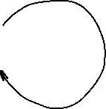

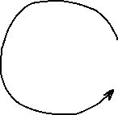
Gene finding with HMMs
Closely related annotated genome: AGAATGGGTAGATAGGATCATAATGGCAAATTGATTTATATTTA
Assume a model:
44 letters, 2 coding->non-coding and 2 non-coding-> coding transitions
Train the model by computing emission probabilities:
Coding: A:9/24, C:1/24, G:8/24, T:6/24
Noncoding: A:8/20, C:1/20, G:2/20, T:9/20
Use Viterbi algorithm to figure out most likely sequence of states (N or C) given the model and emission probabilities; label the letters
21/22
1/22
21/22
Non- coding (N)
Coding (C)
1/22

Slide 39
Viterbi algorithm for HMMs
Start
0.5
0.5
C
A 0.2
C 0.3
G 0.3
T 0.2
N
A 0.3
C 0.2
G 0.2
T 0.3
0.5
0.5
0.6
0.4
Let's consider the following simple HMM for coding/non-coding regions of DNA. This model is composed of 2 states, C (coding) and N (non-coding).

Slide 40
Viterbi algorithm for HMMs
Start
0.5
0.5
C
A 0.2
C 0.3
G 0.3
T 0.2
N
A 0.3
C 0.2
G 0.2
T 0.3
0.5
0.5
0.6
0.4
Consider the sequence S = GGCACTGAA
There are several paths through hidden states (C and N) that lead to this sequence, e.g. NNCCCCNNN
Prob(S) through this path is 0.5*0.2*0.6*0.2*0.4*0.3*...

Slide 41

Viterbi algorithm for HMMs
Start
0.5
0.5
C
A 0.2
C 0.3
G 0.3
T 0.2
N
A 0.3
C 0.2
G 0.2
T 0.3
0.5
0.5
0.6
0.4
Andrew James Viterbi
Image credit: Wikipedia
Consider the sequence S = GGCACTGAA
There are several paths through hidden states (C and N) that lead to this sequence, but they do not have the same probability
The Viterbi algorithm allows us to compute the most probable (best) path

Slide 42
Viterbi algorithm for HMMs
Start
Consider the sequence S = GGCACTGAA
The probability of the best path ending in state l with observation i is:
0.5
0.5
C
A 0.2
C 0.3
G 0.3
T 0.2
N
A 0.3
C 0.2
G 0.2
T 0.3
0.5
0.5
0.6
0.4
$$p_{l}\left(i,x\right)=e_{l}\left(i\right)\max_{k=(N,C)}{(}p_{k}\left(j,x−1\right)∗p_{kl})$$
Probability to observe element i in state l
Probability of the best path ending at position x-1 in state k with element j
Probability of transition from state k to state l

Slide 43
Viterbi algorithm for HMMs
Start
Consider the sequence S = GGCACTGAA
The probability of the best path ending in state l with observation i is:
In our example, the probability of the best path ending in state l=C with “A” at the 4th position is:
0.5
0.5
C
A 0.2
C 0.3
G 0.3
T 0.2
N
A 0.3
C 0.2
G 0.2
T 0.3
0.5
0.5
0.6
0.4
$$p_{l}\left(i,x\right)=e_{l}\left(i\right)\max_{k=(N,C)}{(}p_{k}\left(j,x−1\right)∗p_{kl})$$
$$p_{C}\left(A,4\right)=e_{C}\left(A\right)\max_{k}{(}p_{N}\left(C,3\right)∗p_{NC},p_{C}\left(C,3\right)∗p_{CC})$$

Slide 44
Viterbi algorithm for HMMs
For simplicity, let’s convert everything to log₂(p):
Start
0.5
0.5
C
A 0.2
C 0.3
G 0.3
T 0.2
N
A 0.3
C 0.2
G 0.2
T 0.3
0.5
0.5
0.6
0.4

Slide 45
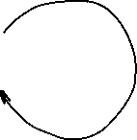
Viterbi algorithm for HMMs
For simplicity, let’s convert everything to log₂(p):
This allows us to add probabilities instead of multiplying, which is more efficient and accurate
Start
-1
-1
C
A -2.322
C -1.737
G -1.737
T -2.322
N
A -1.737
C -2.322
G -2.322
T -1.737
-1
-1
-0.737
-1.322

Slide 46
Viterbi algorithm for HMMs
Start
S = GGCACTGAA
Log probability that the first G was emitted by state C:
Log probability that the first G was emitted by state N:
-1
-1
C
A -2.322
C -1.737
G -1.737
T -2.322
N
A -1.737
C -2.322
G -2.322
T -1.737
-1
-1
-0.737
$$p_{C}\left(G,1\right)=−1−1.737=−2.737$$
-1.322
$$p_{N}\left(G,1\right)=−1−2.322=−3.322$$

Slide 47
Viterbi algorithm for HMMs
Start
S = GGCACTGAA
Log probability that the second G was emitted by state C:
Log probability that the second G was emitted by state N:
-1
-1
C
A -2.322
C -1.737
G -1.737
T -2.322
N
A -1.737
C -2.322
G -2.322
T -1.737
-1
-1
-0.737
-1.322
$$p_{C}\left(G,2\right)=−1.737+\max\left(p_{C}\left(G,1\right)+p_{CC},p_{N}\left(G,1\right)+p_{NC}\right)=−5.474$$
$$p_{N}\left(G,2\right)=−2.322+\max\left(p_{C}\left(G,1\right)+p_{CN},p_{N}\left(G,1\right)+p_{NN}\right)=−6.059$$

Slide 48
Viterbi algorithm for HMMs
Start
S = GGCACTGAA
Log probability that the second G was emitted by state C:
Log probability that the second G was emitted by state N:
-1
-1
C
A -2.322
C -1.737
G -1.737
T -2.322
N
A -1.737
C -2.322
G -2.322
T -1.737
-1
-1
-0.737
-1.322
$$p_{C}\left(G,2\right)=−1.737+\max\left(p_{C}\left(G,1\right)+p_{CC},p_{N}\left(G,1\right)+p_{NC}\right)=−5.474$$
-2.737-1
-3.322-1.322
$$p_{N}\left(G,2\right)=−2.322+\max\left(p_{C}\left(G,1\right)+p_{CN},p_{N}\left(G,1\right)+p_{NN}\right)=−6.059$$
-2.737-1
-3.322-0.737

Slide 49
Viterbi algorithm for HMMs
Start
S = GGCACTGAA
Log probability that the second G was emitted by state C:
Log probability that the second G was emitted by state N:
-1
-1
C
A -2.322
C -1.737
G -1.737
T -2.322
N
A -1.737
C -2.322
G -2.322
T -1.737
-1
-1
-0.737
-1.322
$$p_{C}\left(G,2\right)=−1.737+\max\left(p_{C}\left(G,1\right)+p_{CC},p_{N}\left(G,1\right)+p_{NC}\right)=−5.474$$
-2.737-1
-3.322-1.322
$$p_{N}\left(G,2\right)=−2.322+\max\left(p_{C}\left(G,1\right)+p_{CN},p_{N}\left(G,1\right)+p_{NN}\right)=−6.059$$
-2.737-1
-3.322-0.737

Slide 50
Viterbi algorithm for HMMs
Start
S = GGCACTGAA
Iteratively compute probabilities:
-1
-1
C
A -2.322
C -1.737
G -1.737
T -2.322
N
A -1.737
C -2.322
G -2.322
T -1.737
-1
-1
-0.737
-1.322
 | G | G | C | A | C | T | G | A | A
C | -2.73 | -5.47 | -8.21 | -11.53 | -14.01 | ... |  |  | -25.65
N | -3.32 | -6.06 | -8.79 | -10.94 | -14.01 | ... |  |  | -24.49

Slide 51
Viterbi algorithm for HMMs
Start
S = GGCACTGAA
Backtrack:
-1
-1
C
A -2.322
C -1.737
G -1.737
T -2.322
N
A -1.737
C -2.322
G -2.322
T -1.737
-1
-1
-0.737
-1.322
 | G | G | C | A | C | T | G | A | A
C | -2.73 | -5.47 | -8.21 | -11.53 | -14.01 | ... |  |  | -25.65
N | -3.32 | -6.06 | -8.79 | -10.94 | -14.01 | ... |  |  | -24.49

Slide 52
Viterbi algorithm for HMMs
Start
S = GGCACTGAA
Backtrack:
The most probable path is: CCCNNNNNN, its probability is 2^{-24.49}
-1
-1
C
A -2.322
C -1.737
G -1.737
T -2.322
N
A -1.737
C -2.322
G -2.322
T -1.737
-1
-1
-0.737
-1.322
 | G | G | C | A | C | T | G | A | A
C | -2.73 | -5.47 | -8.21 | -11.53 | -14.01 | ... |  |  | -25.65
N | -3.32 | -6.06 | -8.79 | -10.94 | -14.01 | ... |  |  | -24.49

Slide 53
The Viterbi algorithm: summary
The Viterbi algorithm is used to compute the most probable path (as well as its probability). It requires knowledge of the parameters of the HMM model and a particular output sequence and it finds the state sequence that is most likely to have generated that output sequence.
It works by finding a maximum over all possible state sequences.
In sequence analysis, this method can be used for example to predict coding vs non-­coding sequences.
Similar (in spirit) to Smith-Waterman alignment!

Slide 54
Lab #6
Due November 21st at 8:00pm.

Slide 55
Making use of annotated genomes
We assembled and annotated a reference genome:
We know the DNA sequence of the genome
We know positions of all functional elements: exons, introns, transcript and protein coding sequences
How can we use this information:
We can establish the function of genes by protein homology
We can relate genotype to phenotype by looking at a population of individuals and by cataloguing their:
Phenotypes: physical appearance, etc
Genotypes: set of differences between their genome and the reference

Slide 56
Genome Wide Association Study
A genome-wide association study (GWAS) is a method used to identify genetic variants, that are associated with a particular disease or trait by comparing the genomes of many individuals.
It involves comparing the entire genomes of people who have a disease with those who don't, looking for genetic differences that appear more frequently in the affected group. The results help scientists understand the genetic basis of diseases and other traits.

Slide 57
How GWAS works
Participant groups: Researchers assemble two large groups of people: a "case" group with a specific disease or trait and a "control" group without it.
DNA collection: DNA is collected from all participants, often through a blood sample or a cheek swab.
Genotyping: The DNA is then analyzed to identify common genetic variants, typically single nucleotide polymorphisms (SNPs), across the entire genome.
Association testing: Statistical tests are performed to see if any particular SNP variant is found significantly more often in one group than the other. For example, more people with heart disease might have a "C" SNP in a specific gene compared to a "T" SNP, which is more common in the control group.
Interpretation: Variants found more frequently in the case group are considered to be associated with the disease or trait.

Slide 58
What is GWAS used for
Understanding disease: GWAS provides a way to identify genetic risk factors for many diseases, including some types of cancer, heart disease, and neurological disorders.
Improving research: By pinpointing these associated variants, researchers can investigate the specific genes and biological mechanisms that contribute to disease risk.
Developing treatments: Insights from GWAS can serve as a first step toward understanding a disease's underlying causes and eventually lead to the development of new treatments.

Slide 59
The first step in GWAS: Variant Calling
Sequencing: A DNA sample is sequenced to generate many short reads containing genetic information.
Alignment: The generated short reads are aligned (mapped) to a known reference genome.
Variant Identification: Bioinformatic algorithms compare the aligned reads to the reference to identify positions where they differ, indicating a variant.
Variant Call Formatting: The identified variants are compiled into a standardized Variant Call Format (VCF) file.

Slide 60
Types of variants
Single Nucleotide Variants (SNVs): A change in a single DNA base pair, such as a single nucleotide polymorphism (SNP).
Insertions/Deletions (Indels): Short segments of DNA that are inserted or deleted.
Structural Variants (SVs): Larger-scale changes to the genome, including deletions, duplications, inversions, and translocations.

Slide 61
Why variant calling is important
Disease Research: Variant calling helps identify genetic mutations associated with various diseases, including cancer.
Clinical Diagnostics: It provides data for diagnosing genetic conditions and understanding individual predispositions to common health problems.
Evolutionary Studies: Comparing variants across populations helps researchers understand evolutionary relationships and genetic diversity.

